Slide 1
Industrial Training Presentation
Industrial Training at Soft Tech Innovations
Presented By –
Atharv Milind Suryavanshi
Department of Computer Science & Engineering
DKTE Society's Yashwantrao Chavan Polytechnic, Ichalkaranji
Academic Year: 2026 – 27

Slide 2
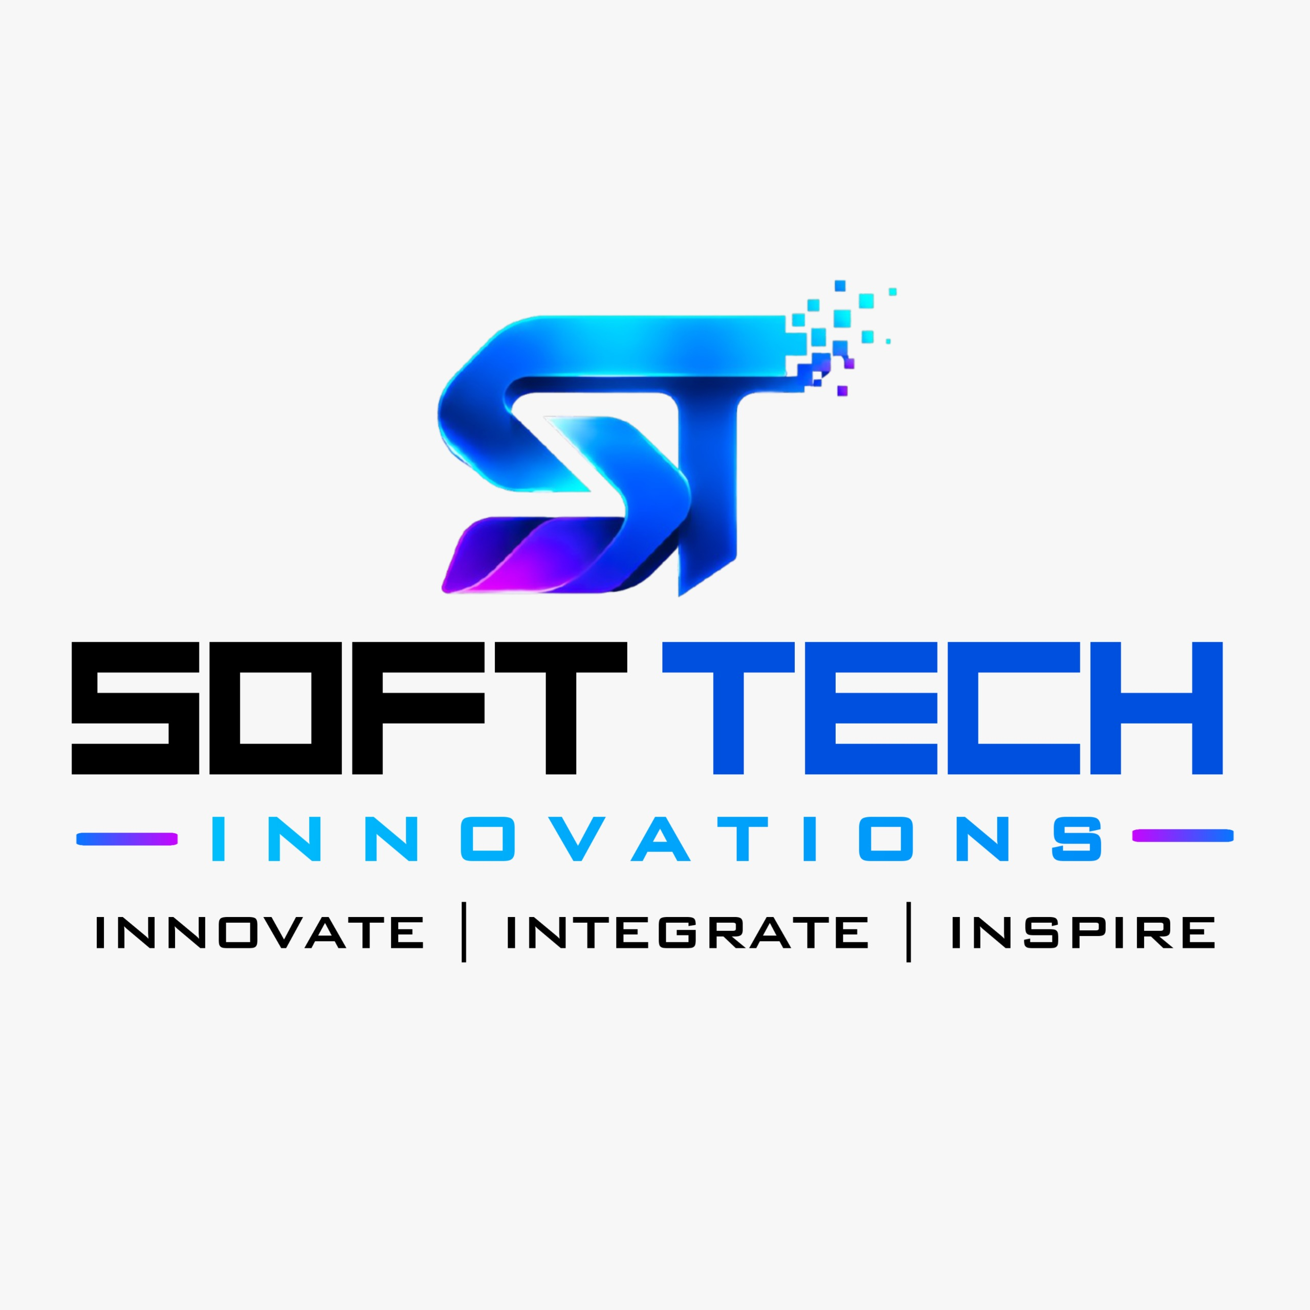
Introduction of the Organization
About Soft Tech Innovations :-
Established in 2011
Formerly known as SoftTech Computer Training Institute
Head Office: Kolhapur, Maharashtra
Branch: Sangli (2024)
Provides software training and software development services
Offers industry-oriented technical education through practical learning
Conducts internships, certification courses, workshops, and live projects
Focuses on Data Science, Data Analytics, Python, Power BI, Machine Learning, Web Development, and Generative Ai
Vision :-
To provide practical, industry-oriented, and job-focused technical education while helping learners develop technical skills, confidence, and professional knowledge.

Slide 3
Objectives of Industrial Training
Objectives :-
Gain practical exposure to industry practices
Apply classroom knowledge to real-world datasets
Learn Data Science and Data Analytics concepts
Develop Python programming skills
Create business intelligence dashboards using Power BI
Learn data cleaning and visualization techniques
Improve analytical and problem-solving skills
Develop professional communication and teamwork skills
Prepare for future career opportunities

Slide 4



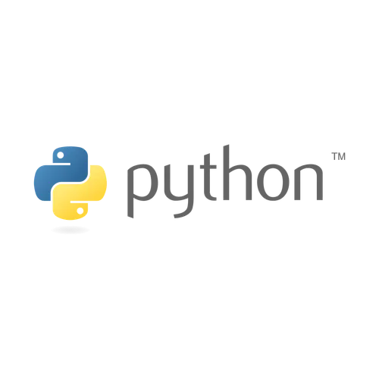




Technologies, Tools & Software Learned
Development Tools
PyCharm
Google Colab
VS Code
Git
GitHub
AI Tools
ChatGPT
Google Gemini
Microsoft Copilot
Documentation
Microsoft Word
PowerPoint
Programming
Python
Data Analysis
NumPy
Pandas
Matplotlib
Seaborn
Business Intelligence
Microsoft Power BI
Power Query Editor
DAX

Slide 5
Tasks and Projects Completed
Practical Tasks
Project
Python programming exercises
Object-Oriented Programming
File handling and exception handling
Data cleaning and preprocessing
Exploratory Data Analysis (EDA)
Feature engineering
Data visualization
Dashboard development
Data transformation using Power Query
Report creation using Power BI
DAX calculations
Major Project 1 - Exploratory Data Analysis using Python
Data cleaning
Data analysis
Data visualization
Report generation
Major Project 2 - Power BI Multipage Dashboard
Interactive dashboards
KPI analysis
Business reports
Multiple report pages
Data visualization

Slide 6
Skills Acquired
Technical Skills
Professional Skills
Python Programming
Data Analysis
Data Cleaning
Data Visualization
Business Intelligence
Power BI
Power Query
DAX
Git & GitHub
Generative AI
Communication
Teamwork
Time Management
Problem Solving
Presentation Skills
Resume Building
Professional Grooming

Slide 7
Challenges Faced & Solutions
Challenges | Solutions
Learning new programming concepts | Regular coding practice and trainer guidance
Cleaning real-world datasets | Used Pandas for preprocessing and handling missing values
Creating interactive dashboards | Practiced Power BI visualizations and report design
Writing DAX formulas | Learned through practical examples and assignments
Understanding AI tools | Explored ChatGPT, Gemini, and Copilot for learning and productivity

Slide 8
Key Learnings & Overall Experience
Key Learnings
Overall Experience
Practical implementation of Data Science concepts
Experience with real-world datasets
Python programming for analysis
Interactive dashboard development
Business Intelligence concepts
Data-driven decision making
Professional work culture
Industry best practices
Successfully completed a 12-week industrial internship
Improved technical and professional skills
Built confidence through practical assignments and projects
Understood industry workflow and project development
Strengthened career readiness in Data Analytics and Business Intelligence

Slide 9
Conclusion
Successfully achieved all internship objectives.
Enhanced knowledge of Python, Data Science, and Power BI.
Gained practical experience through industry-based projects.
Improved analytical thinking and problem-solving skills.
Developed professional and communication skills.
The internship provided a strong foundation for a career in Data Science, Data Analytics, and Business Intelligence.

Slide 10
Thank You
Questions & Answers
Atharv Milind Suryavanshi
Computer Science & Engineering
DKTE Society's Yashwantrao Chavan Polytechnic, Ichalkaranji

